Slide 1
Pharmacy Distributed PEP in North Carolina
Matt Martin (he/they)
Grassroots Advocacy Manager, NC AIDS Action Network
Get in loser, we’re going to the pharmacy.
Matt Martin (he/they)
Grassroots Advocacy Manager, NC AIDS Action Network

Slide 2
Background

Slide 3
NC AIDS Action Network
Mission Statement: The North Carolina AIDS Action Network improves the lives of people living with HIV/AIDS and affected communities through outreach and public education, policy advocacy, and community-building to increase visibility and mutual support of people living with HIV/AIDS throughout our state.

Slide 4
HIV In North Carolina
Approximately 38,400 individuals are living with HIV in North Carolina
It is estimated that 4,400 of those individuals do not know their status
In 2019, there were approximately 1,383 new HIV Diagnoses. The rate of new cases has remained fairly stagnant over the last several years, but we did see an increase in 2019.
As of 2018, there were 3,771 active PrEP users in North Carolina.
Very little data present for PEP services and utilization, which shows the need for increased access and education.

Slide 5
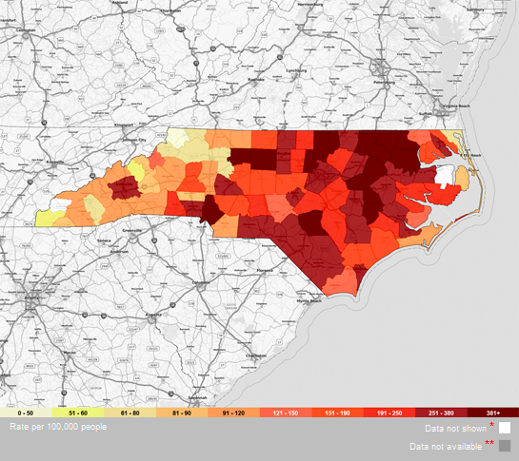
HIV Prevalence in NC
https://aidsvu.org/state/north-carolina/
Notes:
Matt

Slide 6
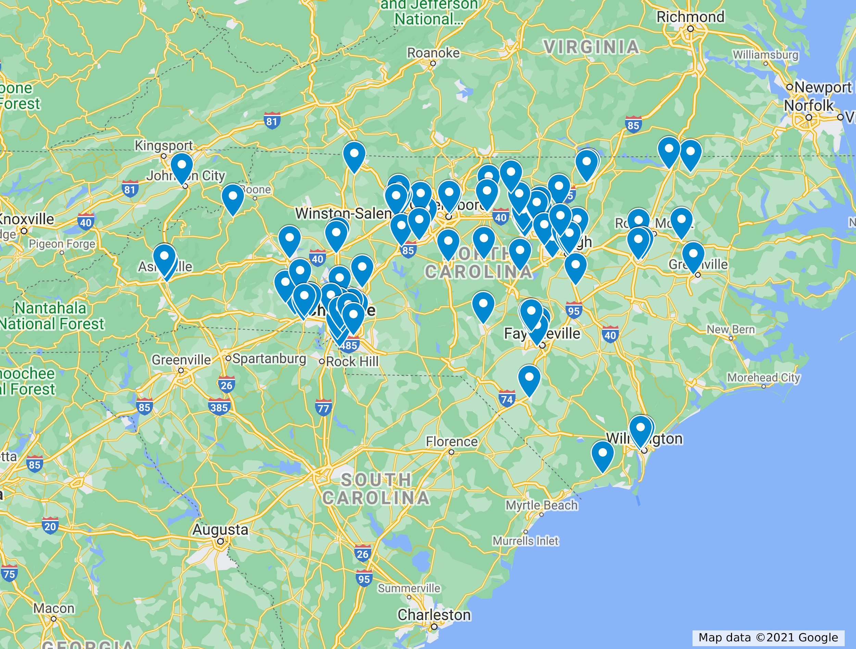
Current PrEP Providers in NC

Slide 7
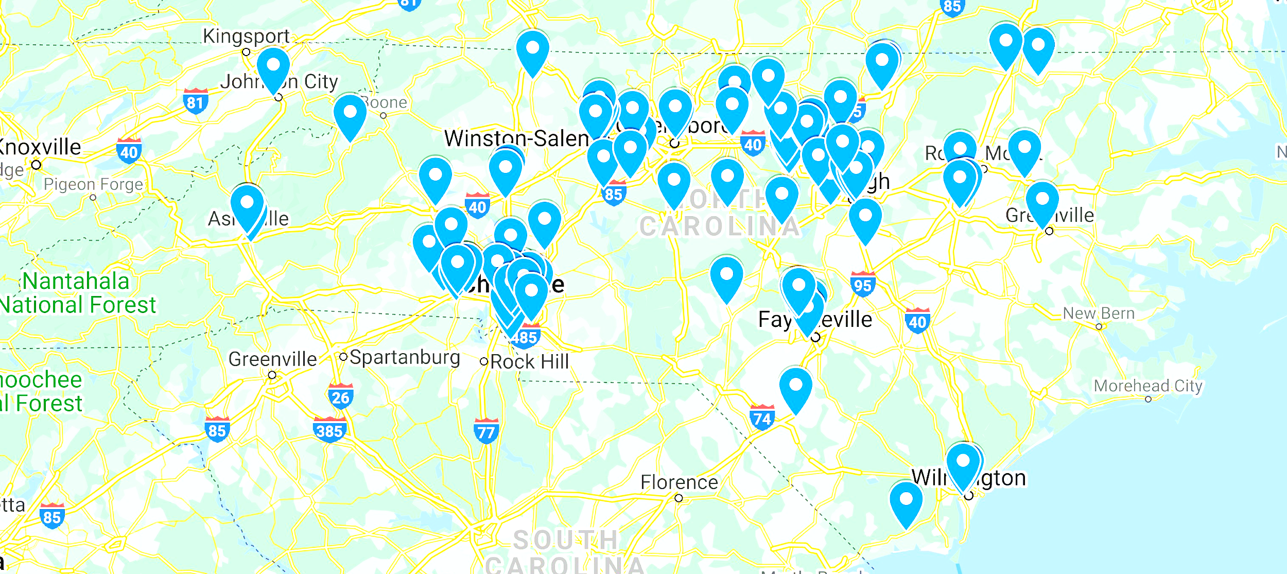

Slide 8
PEP Access Issues
Stigma from physicians and other health care providers
Location of health care facilities
Limited at night and on the weekends
Very little public knowledge of this prevention strategy.

Slide 9
Why pharmacists?
In rural NC (both East and West), there are large “deserts” where there are very few if any providers, especially for HIV services.
Senator Burgin: “There are 5 counties without a family physician, 20 without a pediatrician, 26 without an OB-GYN, and 30 without a psychiatrist.” Pharmacists serve as a main, and often only, source of healthcare for many folks living in rural areas of the state.
72-hour window with starting a PEP regimen makes seeking services outside of the traditional health setting really difficult. This often leaves ER trips as the only option, which can be a major cost for uninsured and underinsured folks.
This is natural fit when our health systems and providers are already spread thin due to the pandemic and appointments are hard to come by.

Slide 10
Pharmacist Administered PrEP and PEP

Slide 11
New York
The first state to allow pharmacist prescribed PEP through PEP starter packs
The New York City Department of Health and Mental Hygiene conducted a survey to push this forward
The New York State Board of Regents issued a standing order. Effective March 2017, pharmacists could:
Prescribe an initial 7-day supply of PEP
Link you to a healthcare provider for an HIV test and remaining 21-day supply of PEP

Slide 12
Legislative Policy Changes

Slide 13
California (SB159)
APLA Health and the California Pharmacist Association were the drivers of the CA legislation
Due to concerns about ongoing pharmacists care, compromised on the final bill. This limits the frequency that individuals can access these services to once every 2 years for PrEP.
Final bill passed in October of 2019 and implemented January 1, 2020. Includes the following:
A pharmacist can administer and interpret an HIV test
A pharmacist can prescribe a 28-day supply of PEP
A pharmacist can prescribe a 30-60 day supply of PrEP
Removes insurance pre-authorization requirements for both PrEP and PEP

Slide 14
Colorado (HB20-1061)
Introduced in January 2020; became law in July 2020
Includes the following:
A pharmacist can administer and interpret an HIV test
A pharmacist can prescribe a 28-day supply of PEP
A pharmacist can prescribe PrEP
Removes insurance pre-authorization requirements for both PrEP and PEP

Slide 15
“Fourteen thousand Coloradans live with HIV today. That’s 14,000 people with compromised immune systems, who have increased vulnerability to viruses like COVID-19. Both HIV and COVID-19 disproportionately impact communities of color, which is why this bill is critical to expanding access to preventative medications for those who need it most.”
-- Senator Dominick Moreno,
Drug Store News

Slide 16
Implementation in California and Colorado
Board approved training programs were released in 2020
Pharmacists are opting in to the programs
Current focus: spreading awareness to pharmacists to enroll
State Board of Pharmacy
Various pharmacist associations

Slide 17
Oregon (HB4116)
Introduced in January 2020
Public hearing concerns (specific to PrEP):
Bill text was vague
Broad scope of practice
Removing pre-authorization requirements
The bill “died” in the 2020 legislative session

Slide 18
Virginia (HB2079)
Broadly around allowing pharmacists to initiate treatment
Included 9 groups of drugs and devices
Distributing PrEP and PEP was one set
Introduced in January 2021; passed in February 2021; signed in to law in March 2021!

Slide 19
How did we do it?

Slide 20
First things first:
Started with internal dialogue with staff and key partners. What could this look like in NC?
Lead to conversations with NC Medical (NCMS) Society, Academy of Family Physicians, and Association of Pharmacists (NCAP)
Most of this happened pre-pandemic, so initial strategies were shaping up a ~little~ differently.
To get this idea out into the public, we wrote several media pieces naming Pharmacist distribution without a prescription.
Worked with Duke MPP student to create a memo outlining this type of policy change across the country.

Slide 21
Teamwork makes the dream work!
After initial conversations, we wanted to stay in touch with the Association of Pharmacists.
We learned that they were hoping to introduce several pieces of legislation during the 2021 session.
The inclusion of HIV prevention methods were a really logical item to include in the full list of medications they were hoping to pass for these types of services of expanded scope.
Once we knew this was going to happen we partnered with Southern AIDS Coalition to advance this policy and ensuring that it was equitable and focused on communities most in need/impacted.

Slide 22
Advocacy Strategy
Prior to moving with any type of legislation/meetings, we created a virtual petition outlining this type of policy. List of signatures was given to NCDHHS Secretary, Dr. Mandy Cohen, on World AIDS Day.
Staff met with representative from APLA in California to discuss their strategies.
Upon discussion with House Health Chair Rep. Donna White (House Republican who is a former communicable diseases nurse), we were urged to meet with Rep. Sasser (R) and Sen. Burgin (R).
Established and cultivated relationships with both members and discussed the importance of these medication’s inclusion.
Staff engaged in multiple public education opportunities, including with our NC community, presenting at NCAP’s conference and NMAC’S Biomedical HIV Prevention Summit.

Slide 23
Advocacy Strategy cont...
Once legislation was introduced — attended all hearings, listening sessions, submitted comments, etc.. Also continued to meet with members of both House and Senate Health Committees
Hosted a community training for NC advocates on the structure of introduced bills and how to speak with representatives about their importance.
HIV Speaks on Jones St (annual advocacy day) had a large focus on these policies and were discussed in every meeting held that day.
NCAAN Team worked with several providers throughout the state to create a letter of support that was sent to both House and Senate Health Committees.

Slide 24
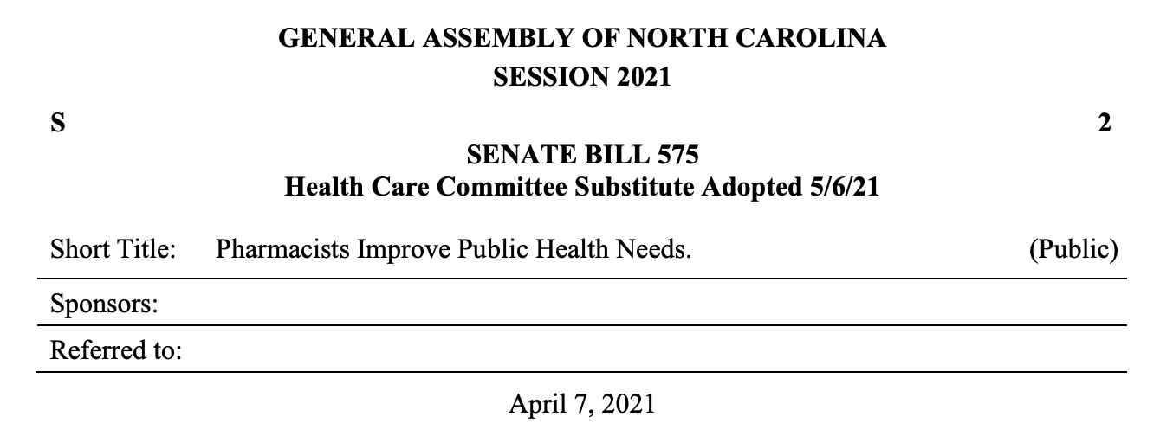
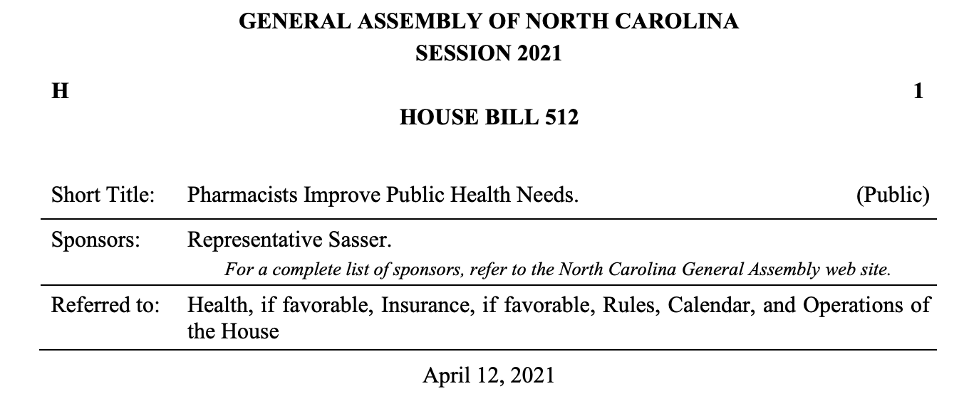
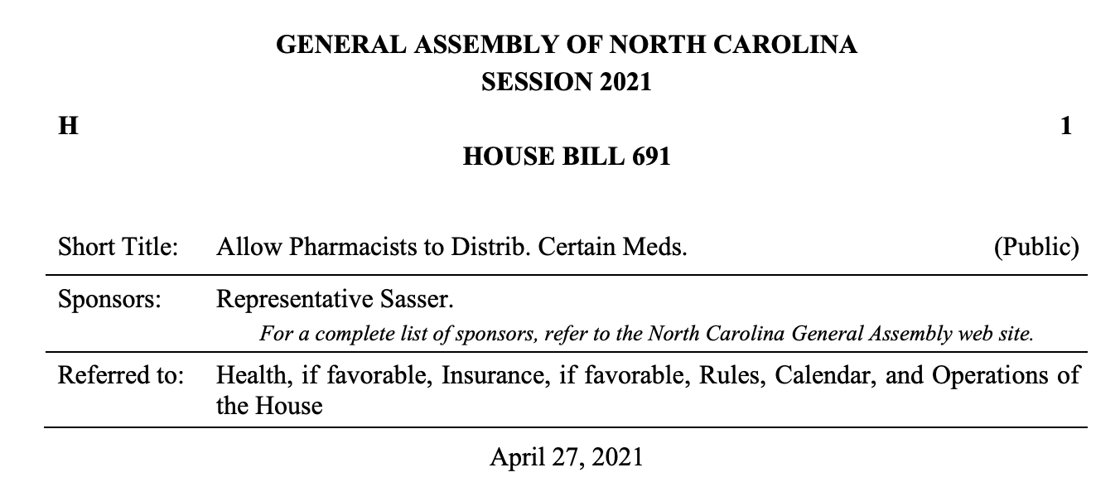
Introduced Legislation (and a few surprises)
Initially three bills were introduced: SB 575, HB 512, and HB 691.
Both SB 575 and HB 512 were identical, but introduced in both chambers in hopes of success either way. These bills included a full list of medications expanding the scope of pharmacists including both PrEP and PEP.
HB 691 was a surprise to us that was solely focused on PrEP and PEP.
Upon conversation with the bill sponsors and NCAP, SB 575 was moving the fastest. Introduced in Senate Health, had some modifications, went to Senate floor for a vote and passed unanimously before crossover (where all bills unheard go to die…).
Due to pushback from the Medical Society and Academy, PrEP was removed from the bill language.

Slide 25
What did we end up with?
SB 575 seemed to be moving, but sponsors were afraid of getting held up in the House. Decided to take language of the bill and add as amendment to existing pharmacist bill, HB 96.
After amendments were introduced the HB 96 moved QUICKLY. Passed every committee hearing, passed Senate unanimously, and had overwhelming support in House upon concurrence (106-5).
There was some pushback on a last minute change to the bill around COVID vaccines for minors. We were opposed to the provision, but luckily it will not have the impact that we initially thought.
House Bill 96 was officially signed into law on 8.20.2021 by Governor Roy Cooper!
What’s next??

Slide 26
Key Takeaways
Start with what and who you know. Figure out who is actively involved and interested, then really cultivate those relationships. (organizationally, legislatively, and in community)
Have realistic expectations. (Timing, movement, modifications, compromise)
Bi-partisan Legislative champions, especially in Southern States, and relational advocacy are essential to advancing progressive and impactful legislation.
Community education, involvement, and leadership should be front and center.
Just because your bill has become a law does not mean the fight is over!
Virtual advocacy is HARD, y’all.

